Slide 1

Chicago Writers’ Block
By Team Pinnacle
Katharine Herringshaw
Julie Wroblewski
Heather Linich

Slide 2
Chicago Writers’ Block
Idea
Create a resource that collects information on Chicago area authors
Concept
Starting point for someone looking into the Chicago literary community
Audience
Literary hobbyist
Those interested in Chicago history

Slide 3
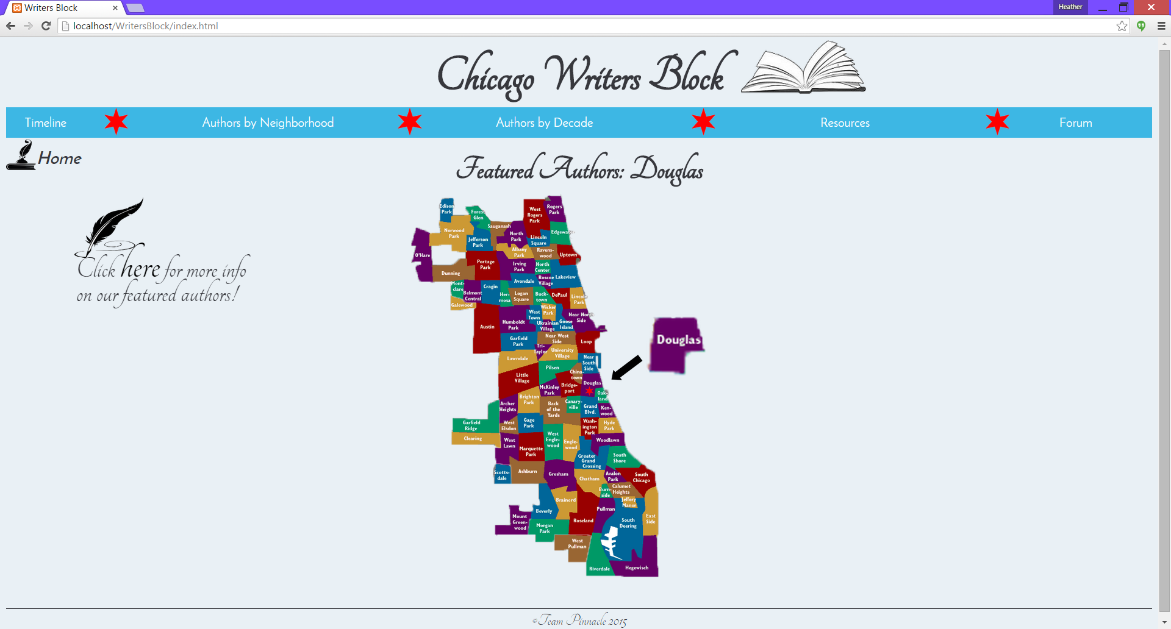
Chicago Writers’ Block
Demo….

Slide 4
Chicago Writers’ Block
Design
Communication
Navigation
User goals
Interactivity

Slide 5
Chicago Writers’ Block
Consistency/Hierarchy
Visual Tools
Affordances
Color
Layout & Images

Slide 6
Chicago Writers’ Block
Additional features
Forum
Resources page with map
Data divided by neighborhood and decade
More author data
City data portal data

Slide 7
Chicago Writers’ Block
Thank you!

